Slide 1
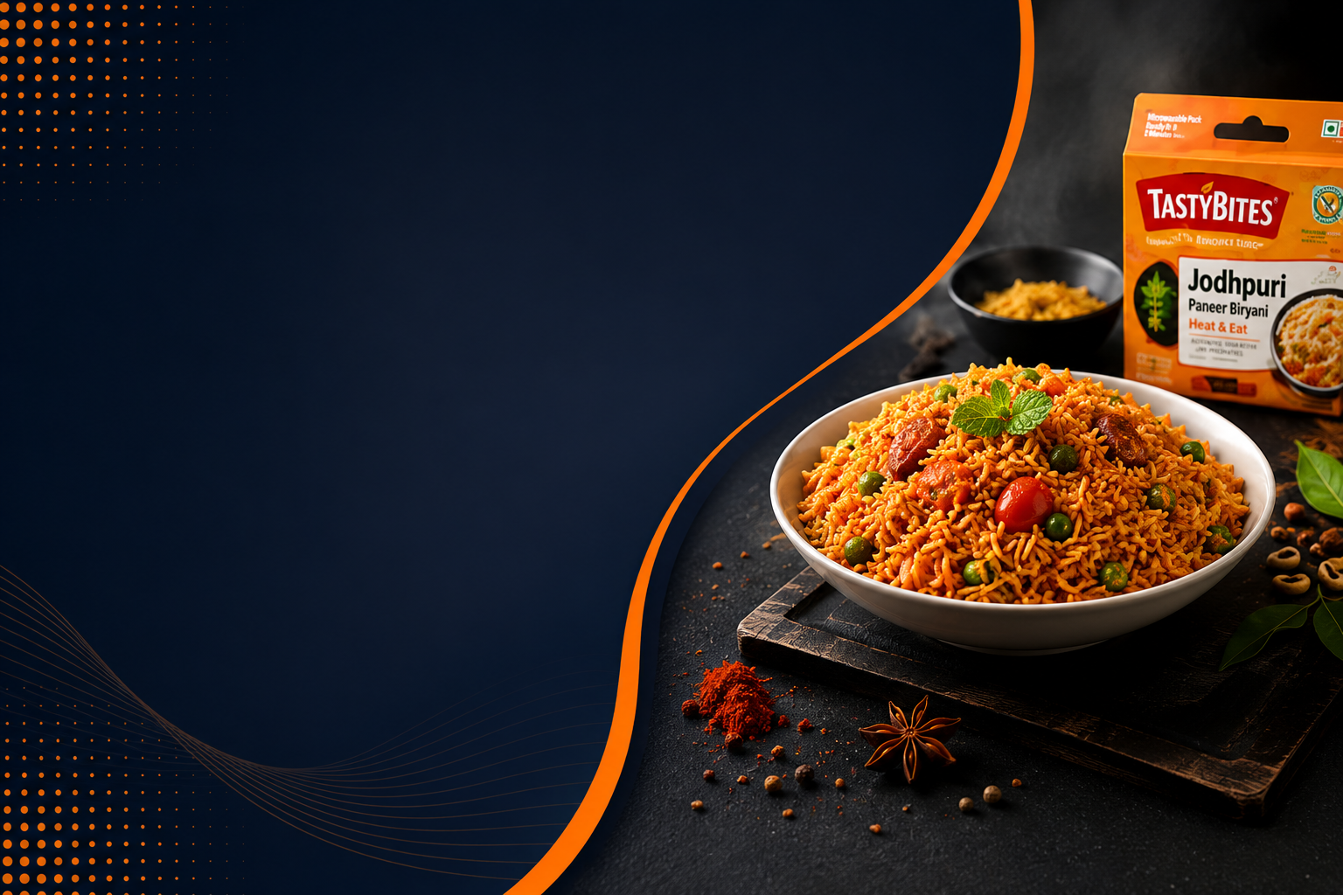
TASTYBITES
SALES & PROFITABILITY
ANALYSIS
"Uncovering what drives profit,
not just sales."
Prepared by
Chandan Kumar Chauhan

Slide 2

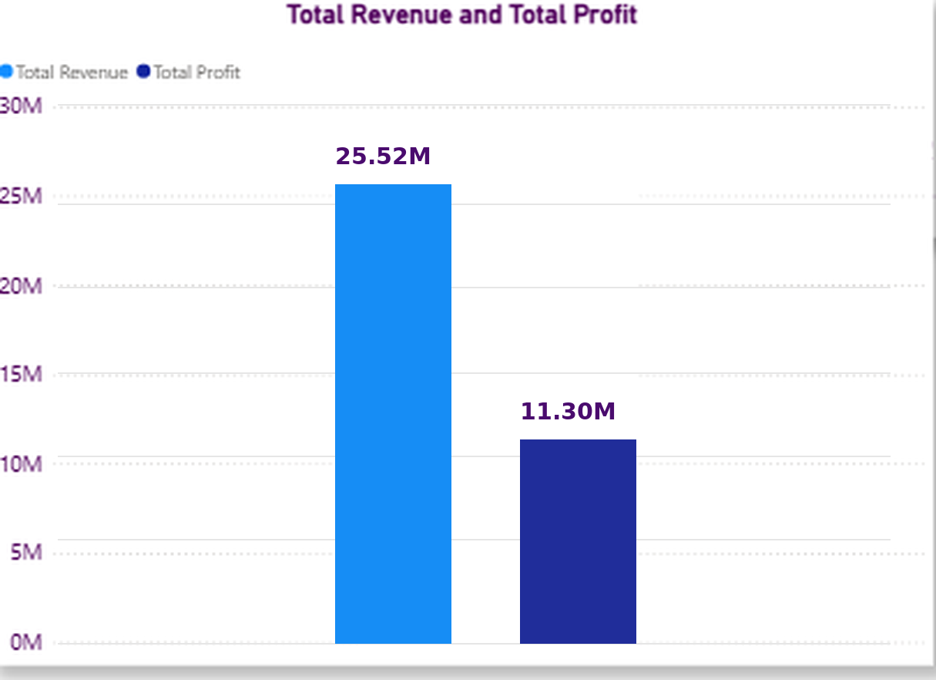
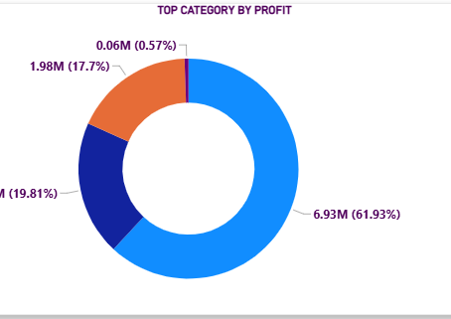
1. Executive Summary
TastyBites continues to deliver strong top-line with healthy profitability, but margin leakage due to discounting needs immediate attention.
Total Revenue
25.52M
Total Profit
11.30M
Profit Margin
44.28%
Quantity Sold
181K
Avg Discount
8.88%
Avg Unit Price
154.36
Key TakeawayStrong revenue base with 44.28% profit margin. Meals is the biggest profit contributor, driving more than two-thirds of total profit.

Slide 3
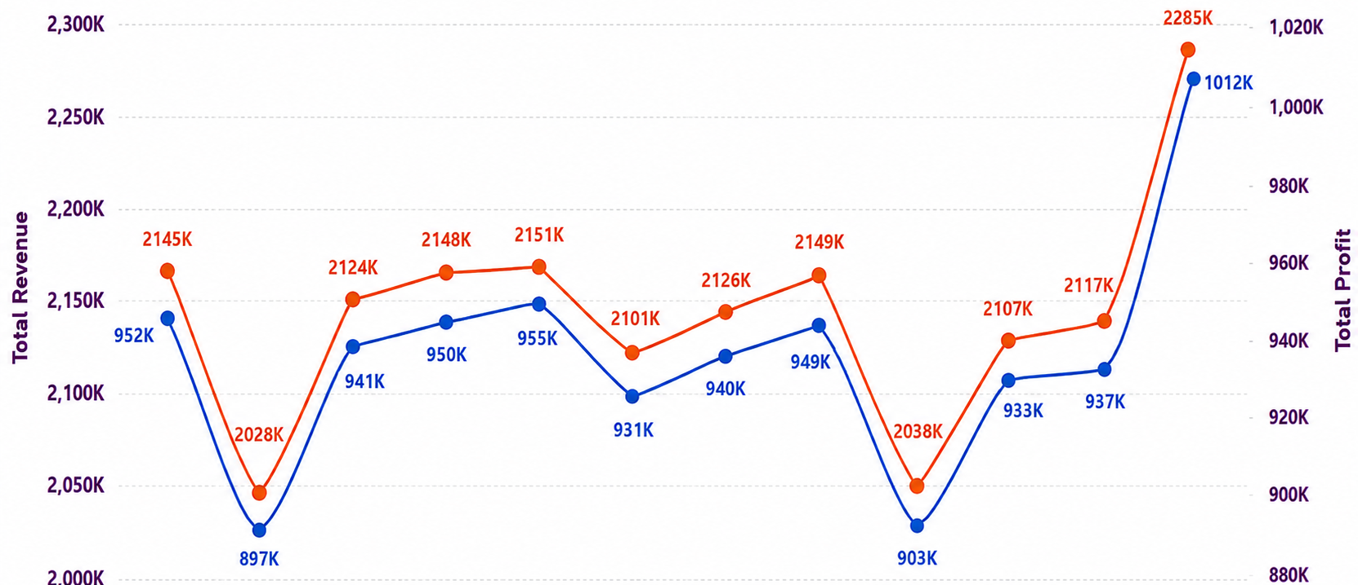
2. GROWTH STORY - MONTHLY PERFORMANCE
Revenue shows seasonality with strong Peak in Nov-Dec and profit follow similar trend, through margin fluctuates.
Key Takeaway Q4 is our strongest quarter. We should plan inventory, promotion and champaigns ahead of the festive season to maximize impact

Slide 4
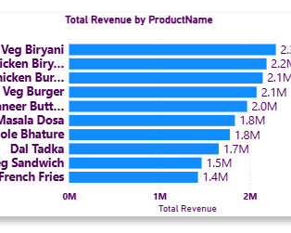
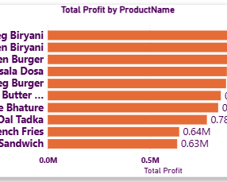
3. PRODUCT PERFORMANCE – REVENUE & PROFIT
Some products drive revenue but not profit. We must focus on profit-led growth.
Top 10 Products by Revenue
Top 10 Products by Profit
Profit Growth Insight Promote our best-performing products like Veg Biryani, Chicken Biryani, and Chicken Burger more, while improving the pricing and costs of Veg Burger and Paneer Butter Chicken so they generate more profit from their strong sales.

Slide 5
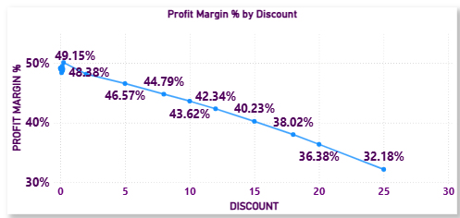
4. DISCOUNT VS PROFIT MARGIN
Profit margin keeps falling as discounts increase, dropping from 49.15% at 0% discount to 32.18% at 25% discount.
Key Takeaway Higher discounts are hurting profitability, so keeping discounts at a moderate level could help the business maintain better profit margins.

Slide 6
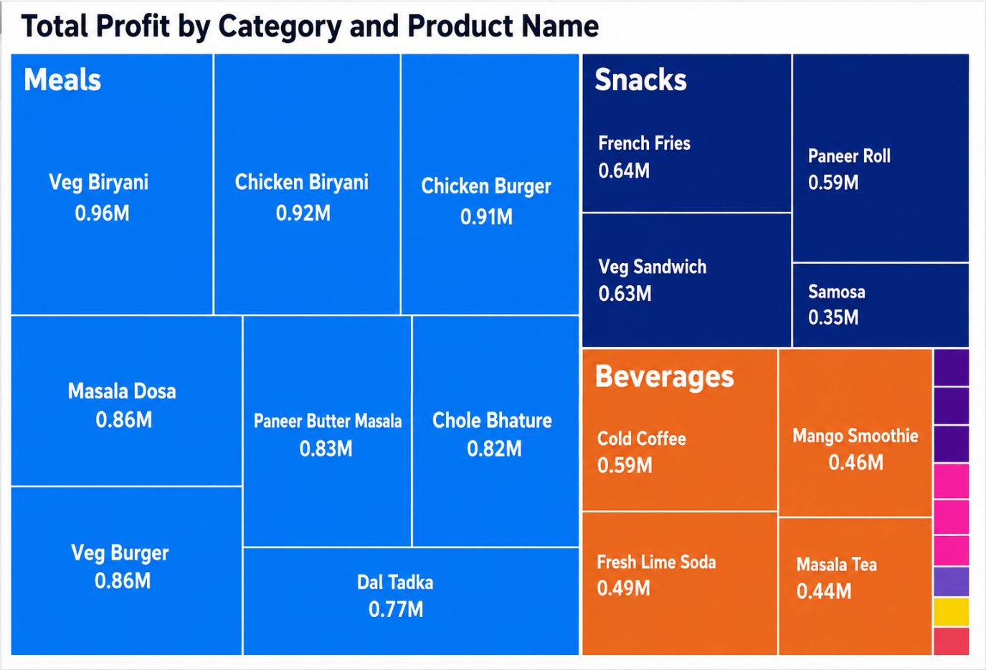
5.PROFIT PERFORMANCE BY CATEGORY & PRODUCT
1. Meals is the strongest profit-generating category.
Veg Biryani leads with 0.96M profit, followed by Chicken Biryani (0.92M) and Chicken Burger (0.91M). This shows that meal products are the main contributors to overall profitability.
2. Snacks also make a strong contribution to profit.
French Fries (0.64M) and Veg Sandwich (0.63M) are the top-performing snack products. These products could be promoted further to support profit growth.
3. Beverages have comparatively lower profit contribution.
Cold Coffee generates the highest beverage profit at 0.59M, while Masala Tea contributes 0.44M. Improving sales of high-potential beverages could create an additional profit opportunity.

Slide 7
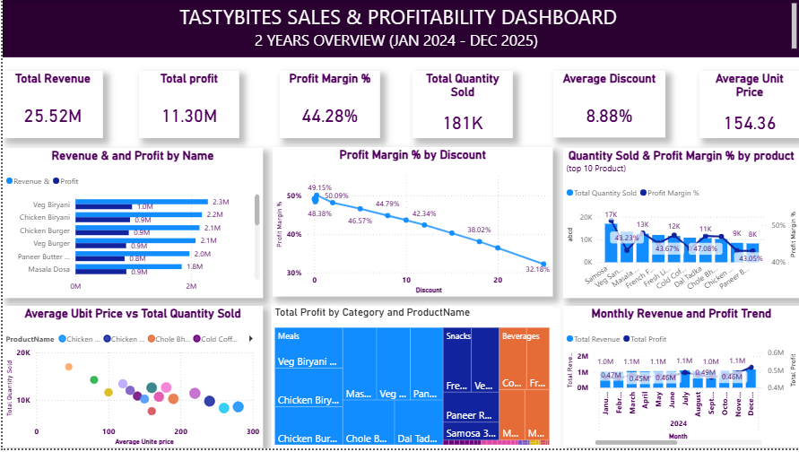
6.EXECUTIVE DASHBOARD

Slide 8
7. STRATEGIES FOR PROFIT GROWTH
⚡ Quick Wins
Products to Promote & Discount Adjustments
Promote Veg Biryani – Highest profit contributor at 0.96M; increase visibility and promotions.
Promote Chicken Biryani & Chicken Burger – Both generate around 0.92M and 0.91M profit, making them strong products for targeted campaigns.
Push high-profit Snacks – Promote French Fries (0.64M) and Veg Sandwich (0.63M) to support additional profit growth.
Reduce heavy discounts – Profit margin falls from 49.15% at 0% discount to 32.18% at 25% discount; avoid unnecessary high discounts.
Review Veg Burger & Paneer Butter Chicken pricing – These products have strong sales but weaker profit, so improve their pricing and/or costs.
📈 Long-Term Strategies
Pricing, Bundling & Category Focus
Implement price optimization – Review pricing for products with strong sales but lower profitability, especially Veg Burger and Paneer Butter Chicken.
Build profitable bundles – Bundle high-profit meals such as Veg Biryani, Chicken Biryani, or Chicken Burger with snacks or beverages to increase order value.
Focus on the Meals category – Meals are the largest profit contributor, generating more than two-thirds of total profit.
Strengthen the Beverage category – Focus on higher-potential beverages such as Cold Coffee, which leads beverage profit at 0.59M, while improving overall beverage sales.
Plan seasonal campaigns around Q4 – November–December and Q4 show the strongest performance, so prepare inventory, promotions, and campaigns ahead of the festive season.

Slide 9
TASTYBITES
THANK YOU
Prepared by: Chandan kumar chauhan
Submitted to: Senior Management & Mentor Review

